Slide 1
Bellman Ford Algorithm Single Source Shortest Path

Slide 2
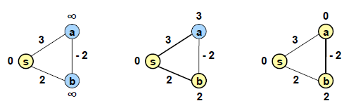
So why is it that Dijkstra’s algorithm does not work with negative edges? What is it in the proof of correctness that fails? Consider the following very simple example:

Slide 3
Dijkstra’s algorithm would visit b then a and leave b with a distance of 2 instead of the correct distance 1.
The problem is that when we consider the closest vertex v not in the visited set,
shortest path may is through only the visited set and
then extended by one edge out of the visited set to v

Slide 4
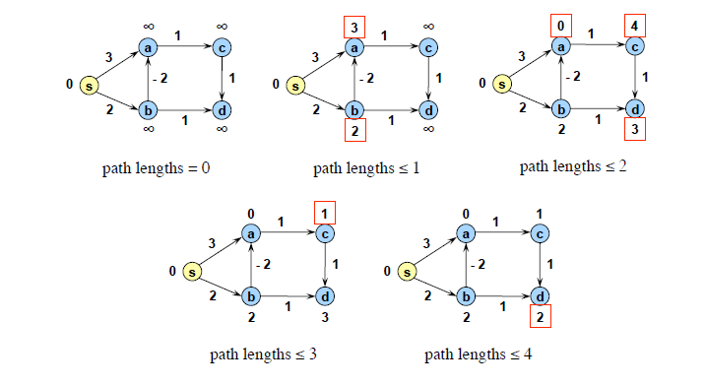

Slide 5
if there is a negative weight cycle reachable from s.
In particular since no simple path can be longer than |V|, if the distance is still changing after |V| rounds, then there must be a negative weight cycle that was entered by the search.
An illustration of the algorithm over several steps is shown in Figure

Slide 6
Refer Algorithm given in corman

